Slide 1
Implementation plan extracted from JAXA’s checklist for BIRDS-X
Items for DFMR | Implementation plan extracted from JAXA’s checklist | Implementation result for BIRDS-X
(1) Inhibits on the positive AND negative current paths. (supply and return). This allows failure of one inhibit and still safe operations. | No chassis connection on the supply or return path between the battery and the inhibits. Any chassis connection must have an inhibit between the chassis and the battery to mitigate the effects of battery short circuits to chassis. | See page 2
(2) Design to have no smart short between hot side and return side | Wiring: Proper insulation (double insulation) Wires connected to the battery positive and wires connected to the battery negative should not be in the same cable bundle. Or Additional insulation layers | See *1 Wiring on page 3
 | Battery: Electrical connections to battery cells (tabs) should be insulated or covered with an insulating layer or cover. Battery tabs and conductive surfaces covered with insulation to prevent shorting from conductive debris. | See *2 Battery on page 3
 | Circuit board: Kapton tape to prevent shorting from FOD, etc. | See *3 Board on page 4
 | Connectors: Either separate connectors for positive and negative conductors, or pin spacing on connectors between positive and negative sufficient to prevent shorting between positive and negative conductors if a connector pin is bent. Cover the battery monitor connector terminal with Kapton. | See *4 Connector on page 4 and 5

Slide 2
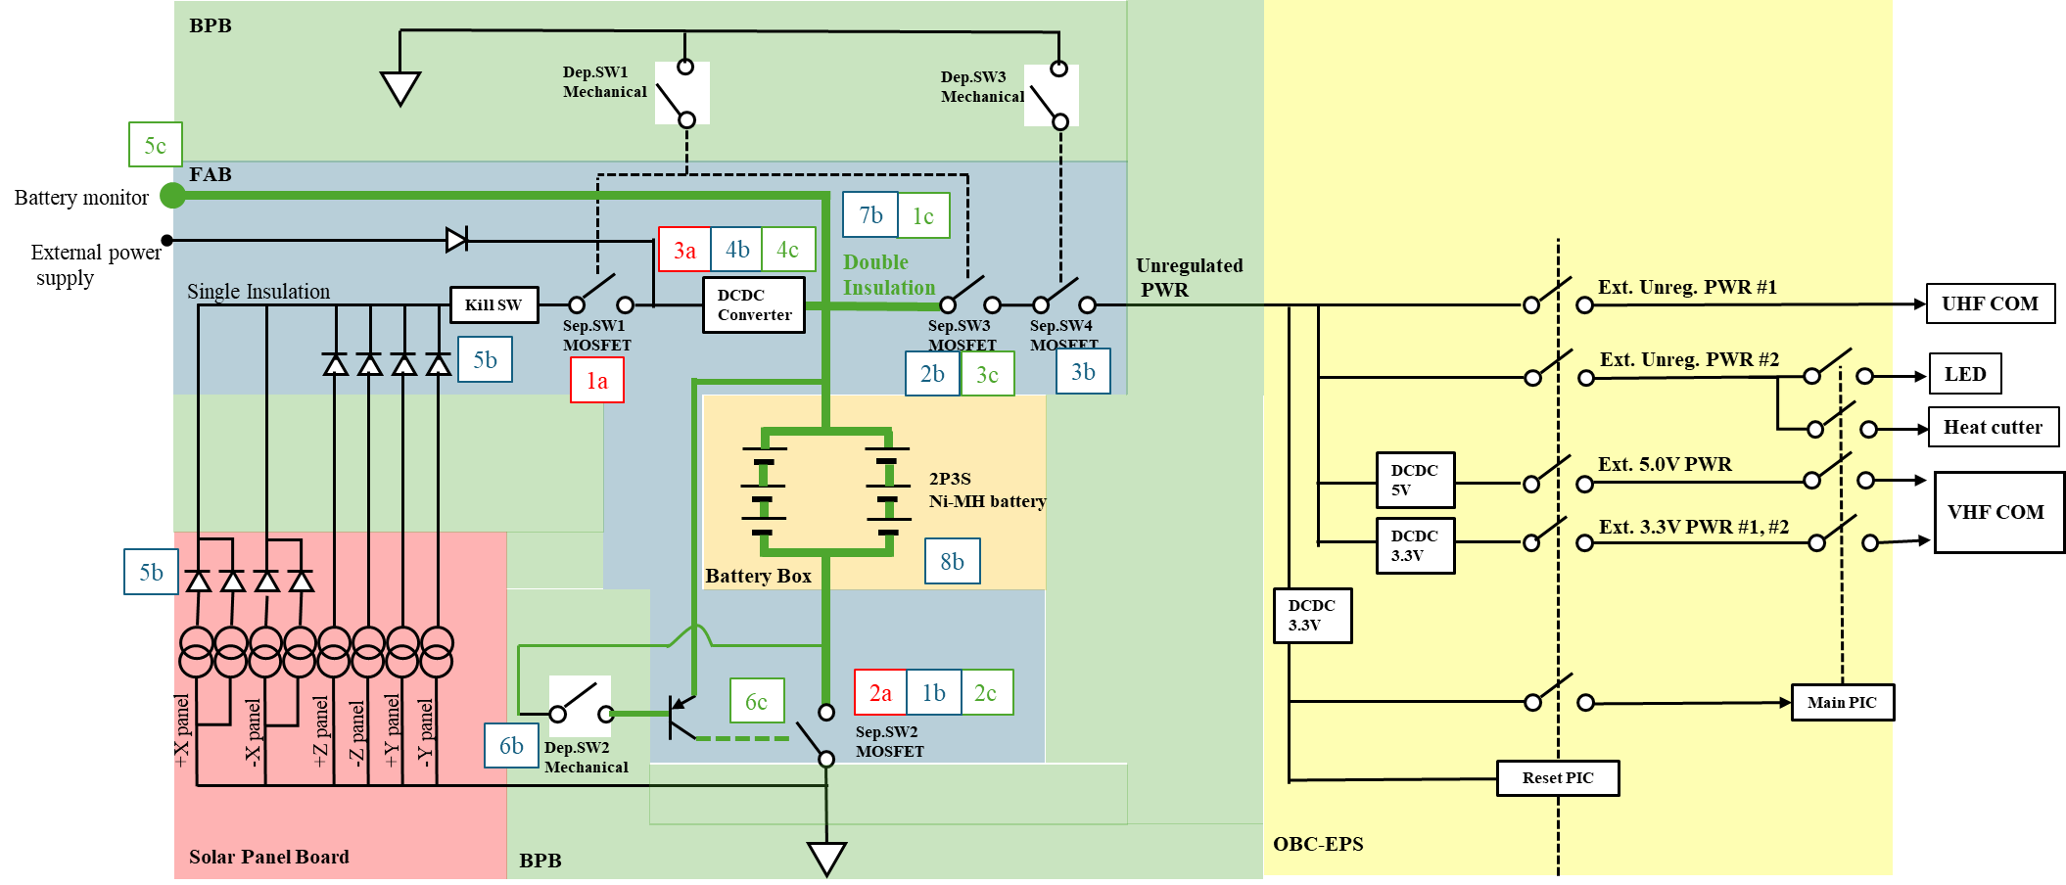
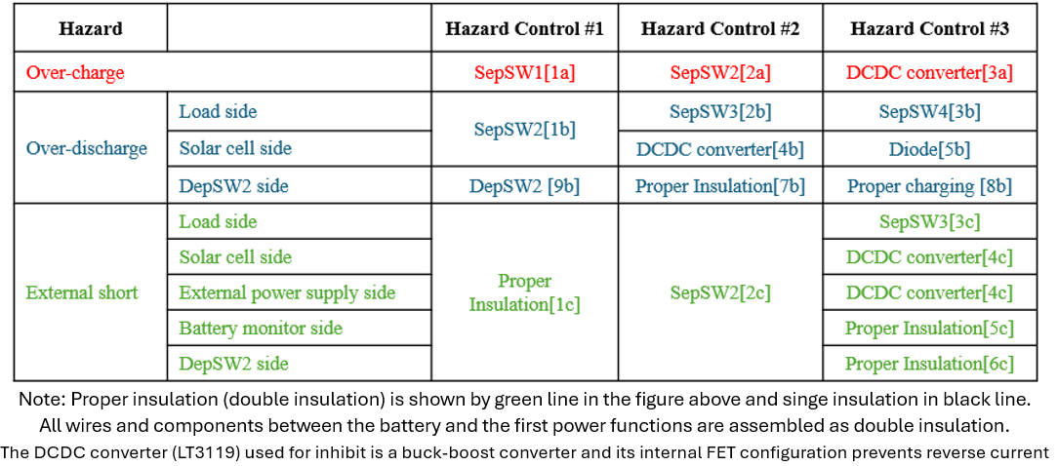
Implementation plan extracted from JAXA’s checklist for BIRDS-X
No chassis connection on the supply path between the battery, DCDC convertor, DepSW2, Battery monitor terminal and SepSW3.
No chassis connection on the return path between the battery and SepSW2.
The Inhibit Schematic is shown on the right.
Inhibit Schematic

Slide 3
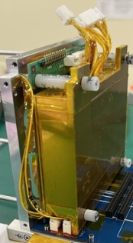
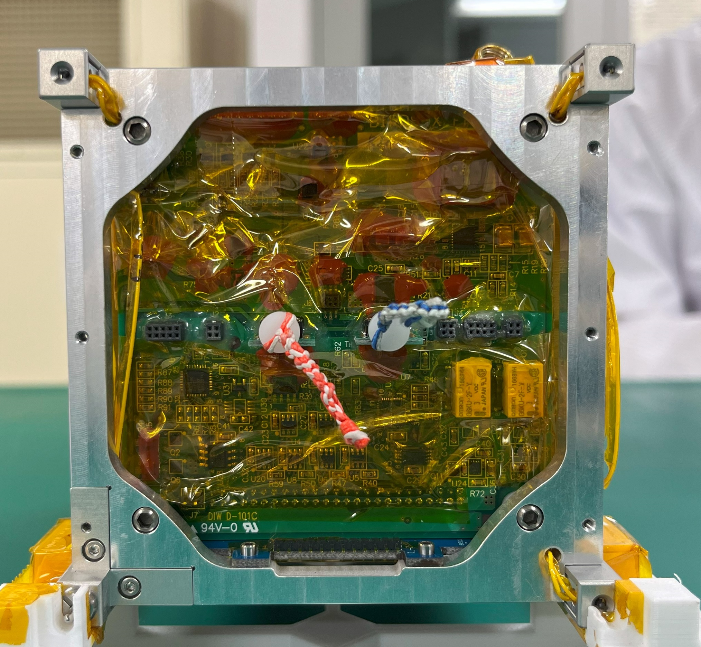
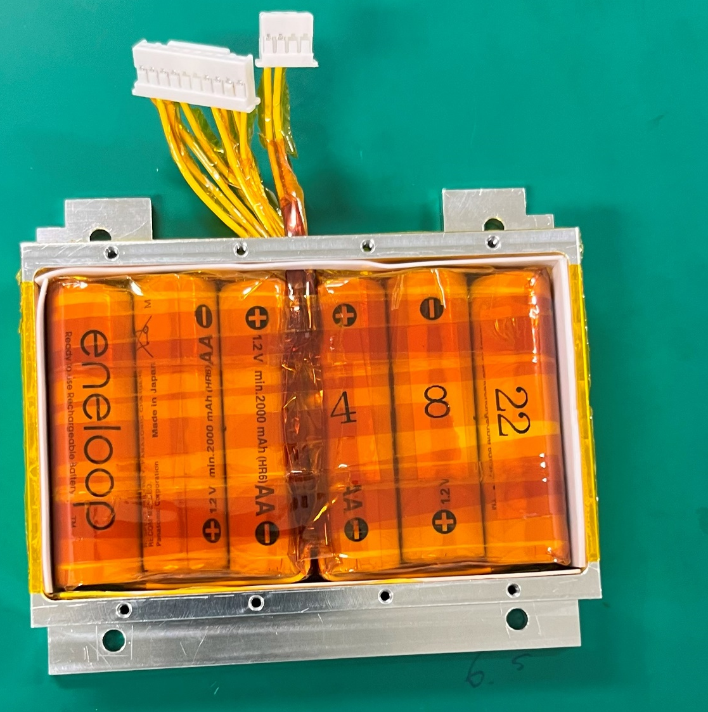
BIRDSX-STD-Attachment-01
Implementation plan extracted from JAXA’s checklist for BIRDS-X
*1 Wiring
*2 Battery
The power wires connecting the battery and the EPS1 board, and the wires of DepSW2 are double insulated (wire insulation and covering by Kapton tape).
Electrical connections to battery cells (tabs) are covered with Kapton tape.
Battery tabs and conductive surfaces are covered with Kapton tape.
The insulation sheets are installed between the battery box and the battery cells.
DepSW1
DepSW2
Y
X
DepSW3

Slide 4
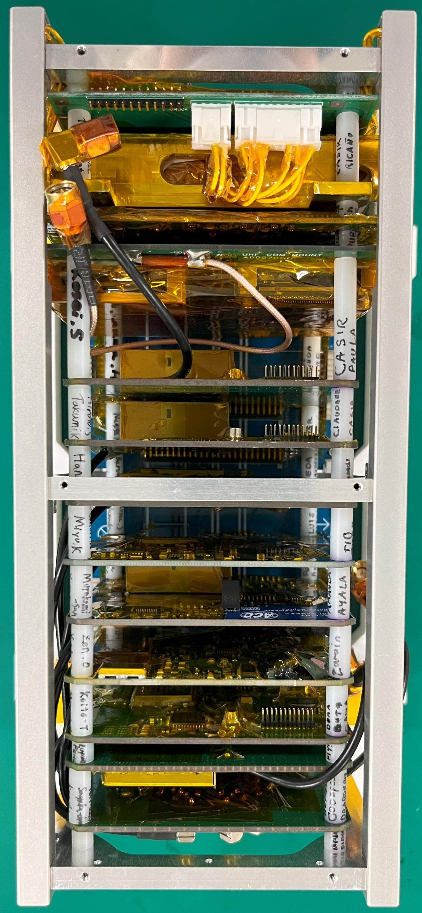
BIRDSX-STD-Attachment-01
Implementation plan extracted from JAXA’s checklist for BIRDS-X
*3 Circuit board
*4 Connectors
The terminals of the electronic elements (marked in orange) from the battery to the first inhibit are covered with RTV.
The entire EPS1 board is covered with Kapton tape.
HOT line and RTN line are not adjacent on the circuit board.
The pins spacing on connectors between positive and negative sufficient.
Power negative pins (four)
Power positive pins (four)
5.5mm
Y
Z

Slide 5
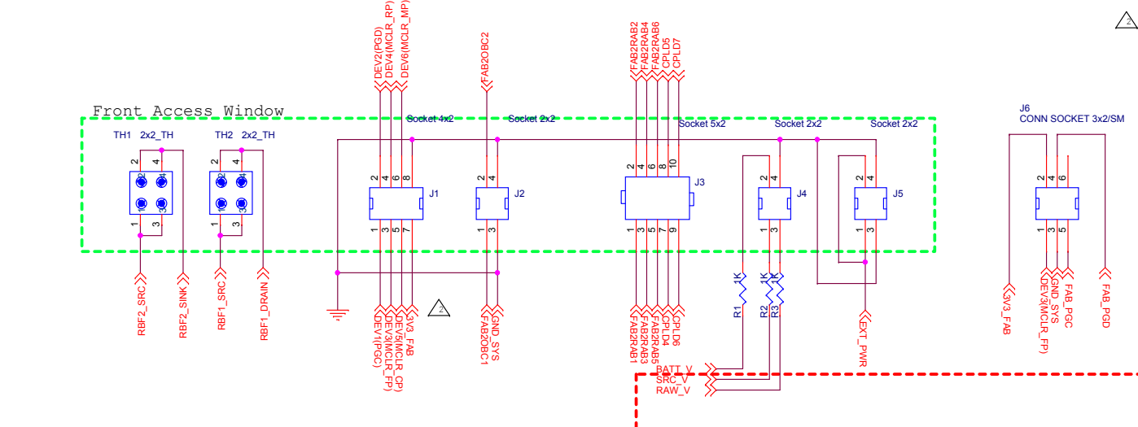
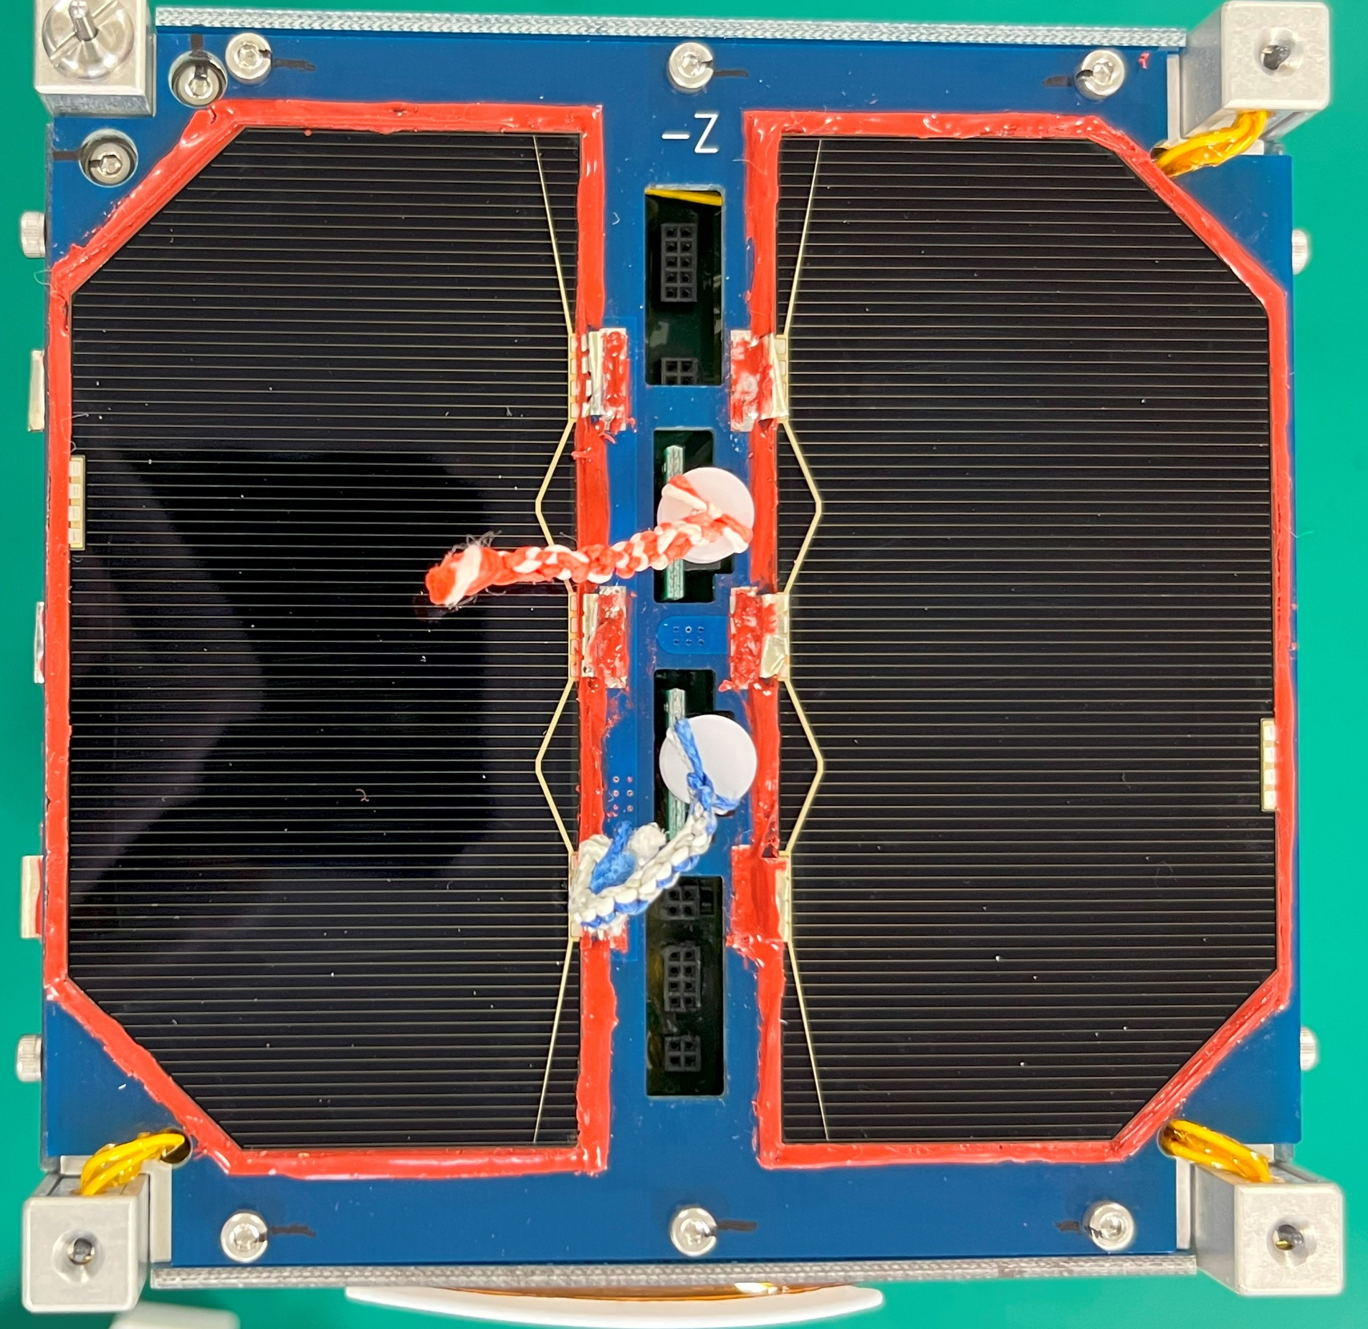
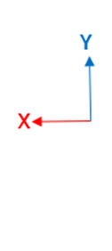
BIRDSX-STD-Attachment-01
Implementation plan extracted from JAXA’s checklist for BIRDS-X
*4 Connectors
The battery monitor connector terminal to be covered with Kapton when the satellite is delivered.
Front Access Window Diagram
Battery Voltage could be monitored by Socket 2X2 (J4)

